Slide 1



Implementation of the Winner-Take-All Circuit for Self-testing Systems in Space Applications
By: Wesley Chu
Mentor: Dr. Janet Wang
Kuiper Space Sciences Bldg
4/16/10

Slide 2
A Brief Outline
The use of circuitry to model an artificial neural system
  Purpose?
  How the circuit functions
Designing the circuit on computer
  Software used (Cadence, HSPICE, WaveViewer Analyzer)
  Results of the design

Slide 3
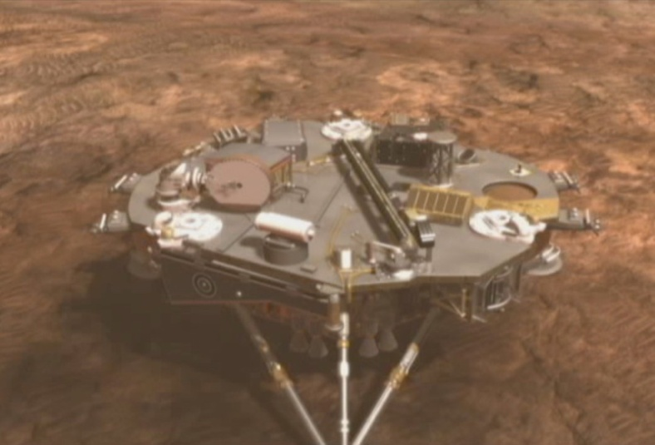

Purpose of the Winner Take All Circuit
Artificial neural systems are required for a system to perform self-checks on itself
  Allows a system to “think” for itself and determine whether there are any errors in itself by checking its sensors
Example of a use:
  An unmanned spacecraft
NASA's Phoenix Spacecraft Lands at Martian Arctic Site." (2008): n. pag. Web. 8 Apr 2010. <http://www.jpl.nasa.gov/news/news.cfm?release=2008-081>.

Slide 4
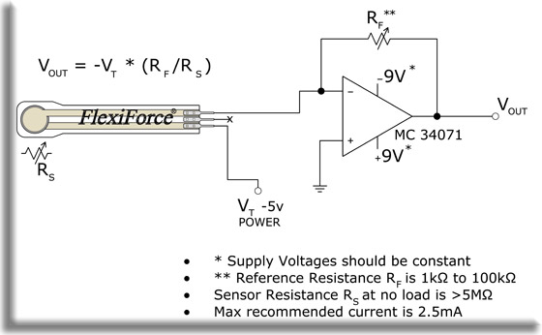
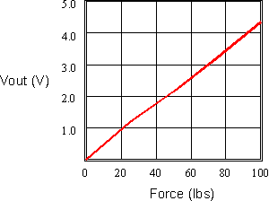



What is a sensor?
Checks for fluctuations in a given variable (force, chemicals, etc) and outputs the change as a voltage (or a current by Ohm’s Law)
Example: Pressure sensor
Recommended Drive Circuit." Trossen Robotics. Web. 9 Apr 2010. <http://www.trossenrobotics.com/flexiforce-100lb-resistive-force-sensor-kit.aspx>.

Slide 5

Many types of sensors!
Sensors have been made for different applications (Pressure, temperature, etc)
As we can expect a spacecraft will have multiple sensors
Since the spacecraft will have multiple sensors it will also need an efficient and fast way to detect any anomalies amongst the sensors
  Solution? Winner Take All Circuit!

Slide 6
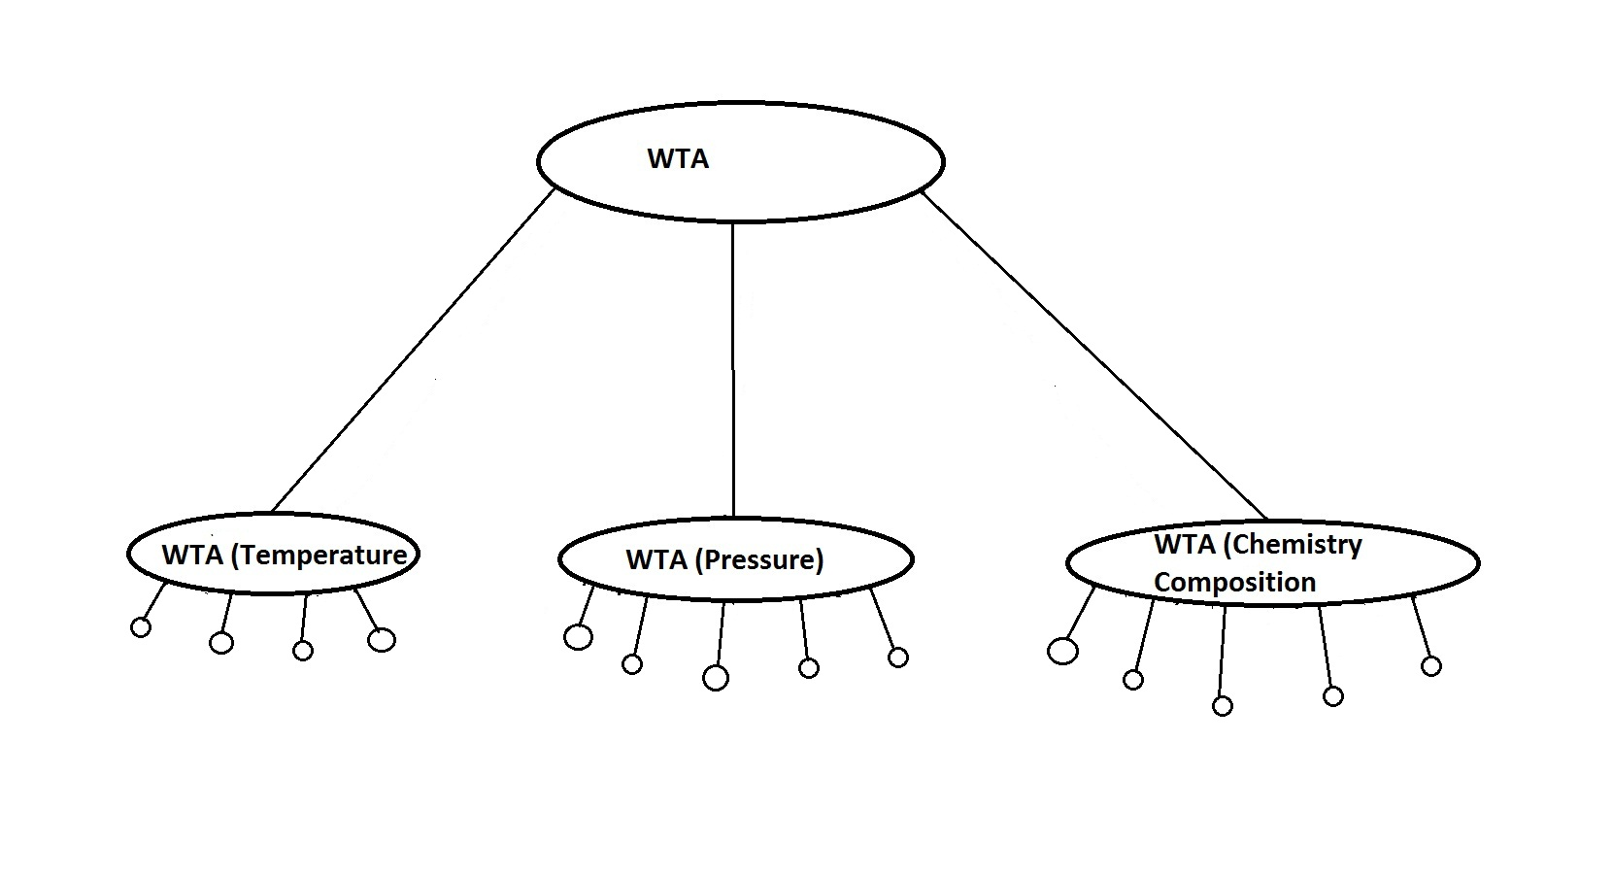

How the Winner Takes All Circuit fits in

Slide 7
How the circuit functions
  Given multiple inputs to check, only the signal from the malfunctioning input will appear on the output
  Each sensor is given its own cell in the circuit
    Thus each cell in the circuit takes an input current from the sensor
  Using MOS technology, an abnormally large input current will appear on the output of the whole circuit
  The other inputs will be inhibited due to the physics of MOS transistors

Slide 8
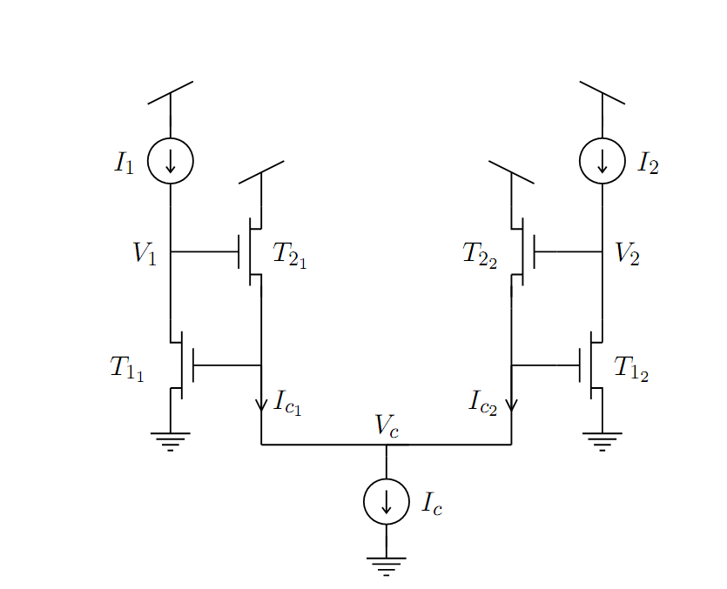
Putting it together..
Let I1 and I2 represent the current from the sensors in this 2 cell Winner Take All Circuit
Cell 2
Cell 1
If I1 and I2 equal each other then the output current will be represented by a sum of the two currents
I1 =
I2 =
Lazzaro, . "Winner-Take-All Networks of O(N) Complexity." 1988. Print.

Slide 9
Putting it together..
Let I1 and I2 represent the current from the sensors
Cell 2
Cell 1
If I1 is larger than I2 then cell 2 will “turn off” (not conduct) and I1 will appear at the output
Vice-versa for the case where I2 is larger than I1
I1= Ic
I2= 0
Lazzaro, . "Winner-Take-All Networks of O(N) Complexity." 1988. Print.

Slide 10

Designing the Winner Take All Circuit
Using computer software, one can design and test the winner take all circuit on the computer
Cadence- software used to design the circuit on the computer
HSPICE- software that displays useful operating information about the circuit
WaveView Analyzer provides a graphical way to see how the current or voltage fluctuates based on how the different input changes

Slide 11
Problems
Software took some time to learn
  Hard to set up
  Debugging

Slide 12
Advantages
HSPICE provides lots of valuable information about the circuit instantly
  Data would otherwise take a long time to calculate by hand
Cadence allows one to change different features on the circuit design
WaveView Analyzer provides visual representation of data

Slide 13
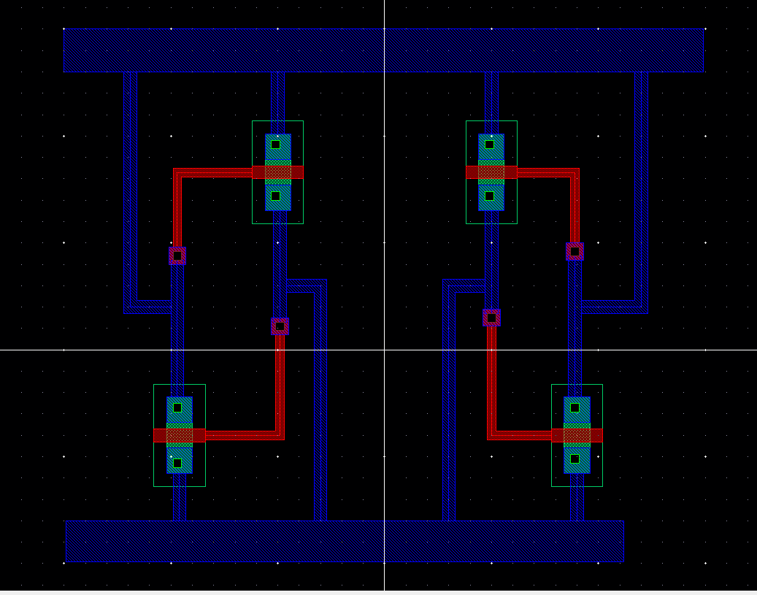


Layout of design using Cadence

Slide 14
Results from HSPICE
**** mosfets
subckt
element 0:m3 0:m2 0:m1 0:m0
model 0:cmosn 0:cmosn 0:cmosn 0:cmosn
region Saturati Saturati Saturati Saturati
id 500.0000u 10.0000u 10.0000u 500.0000u
ibs 0. 0. 0. 0.
ibd 0. 0. 0. 0.
vgs 1.8024 696.9278m 696.9278m 1.8024
vds 1.3031 2.4993 2.4993 1.3031
vbs 0. 0. 0. 0.
vth 578.0413m 494.5086m 494.5086m 578.0413m
vdsat 578.5420m 165.6841m 165.6841m 578.5420m
vod 1.2244 202.4191m 202.4191m 1.2244
beta 1.3717m 441.1317u 441.1317u 1.3717m
gam eff 594.2106m 583.4056m 583.4056m 594.2106m
gm 550.9892u 79.7095u 79.7095u 550.9892u
gds 41.7814u 2.3960u 2.3960u 41.7814u
gmb 134.7623u 23.3790u 23.3790u 134.7623u
cdtot 1.0717f 322.9041a 322.9041a 1.0717f
cgtot 5.9344f 1.7988f 1.7988f 5.9344f
cstot 3.0976f 938.8570a 938.8570a 3.0976f
cbtot 1.0886f 370.6663a 370.6663a 1.0886f
cgs 4.7438f 1.4035f 1.4035f 4.7438f
cgd 1.0191f 306.9245a 306.9245a 1.0191f

Slide 15
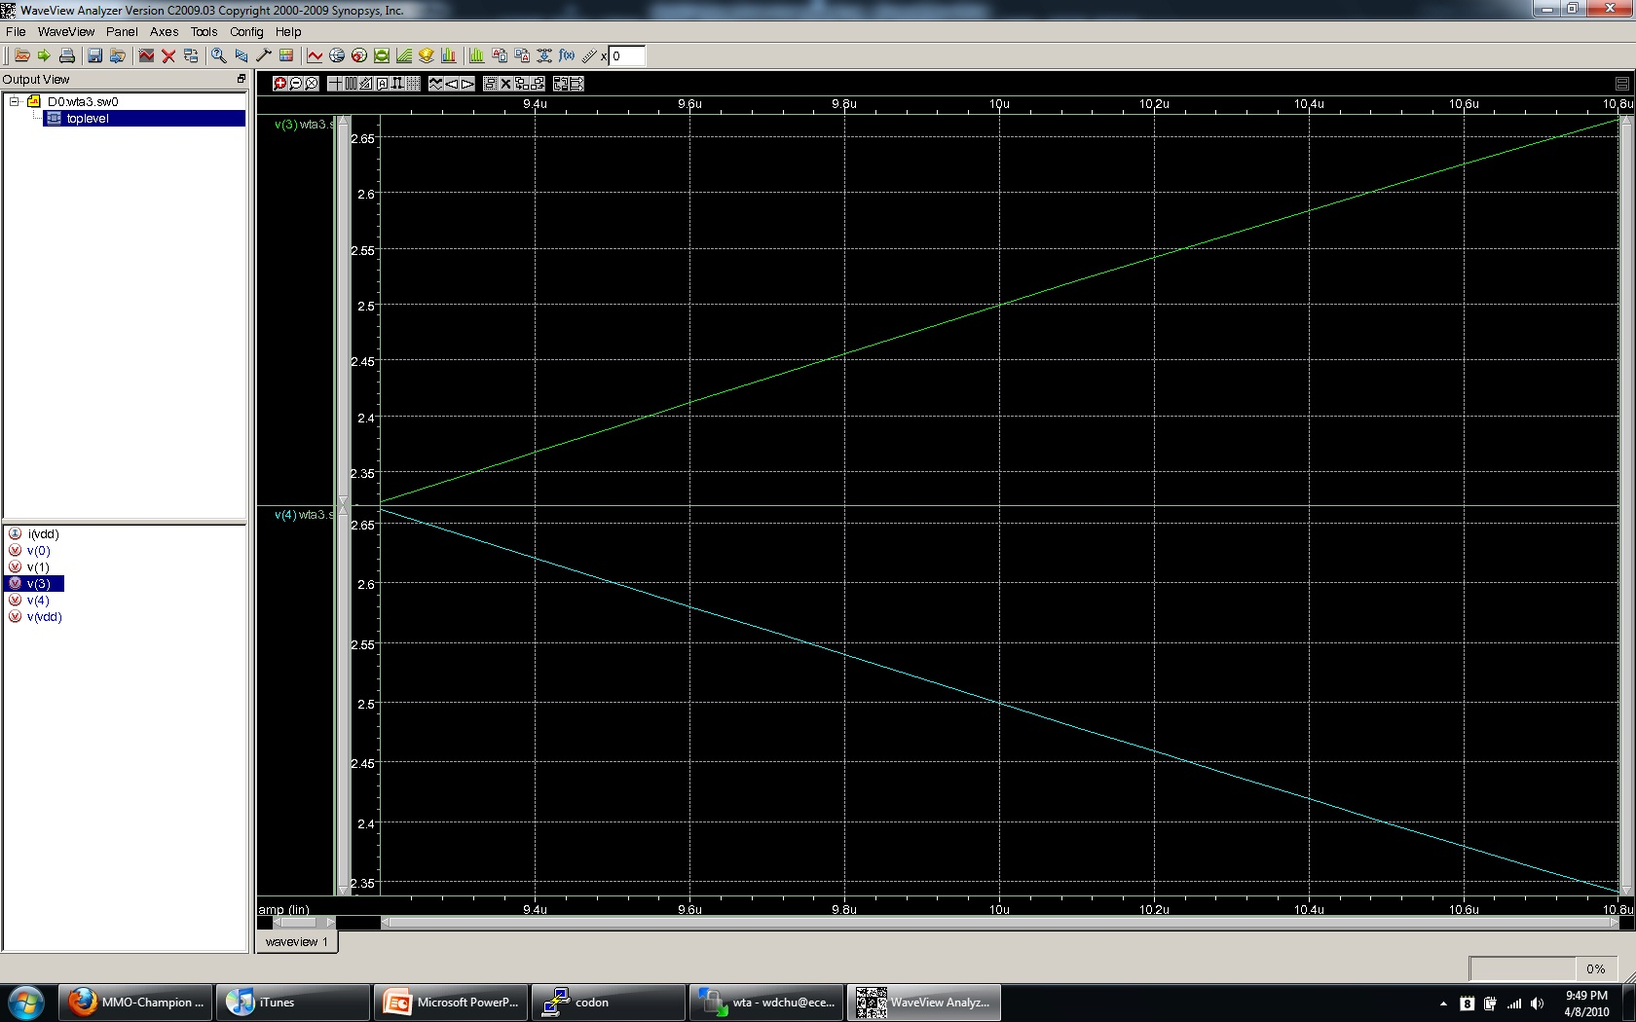


Results from WaveView Analyzer

Slide 16
Improvements?
Using software, one can make changes easily to the circuit as well as determine how the circuit is affected by the change
  Various features can be improved in the circuit (power consumption, time response, etc..)

Slide 17
Thank You

